Slide 1
Project Description: Instagram Analysis
Being a Data analyst I need to find useful insights from Instagram data set. I will be using SQL to find out the user interactions and engagement to provide insights and help the Teams at Instagram to increase their business growth. These insights can be used with various team such as marketing Team, Development Team etc.
Presented By: Rakhi Kumari
Data Analytics Trainee

Slide 2
Approach
I will be using MYSQL to execute the command. I am going to try my best to optimize my code so it will be easy to understand and comprehend.
I will try to extract the exact answers to the queries.

Slide 3
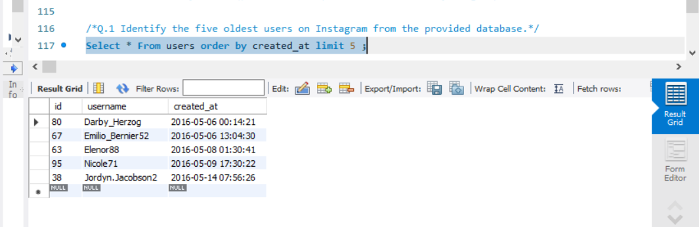
Q.1 Identify the five oldest users on Instagram from the provided database.

Slide 4
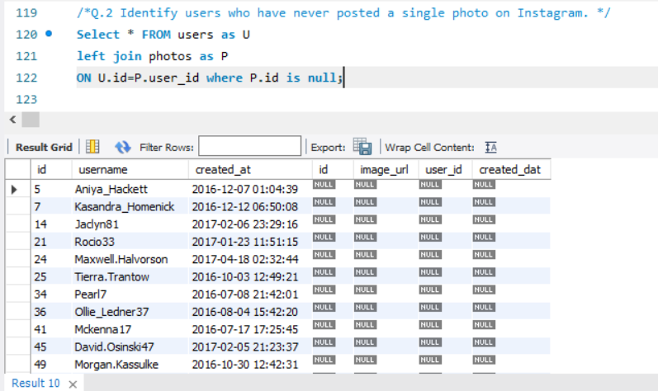
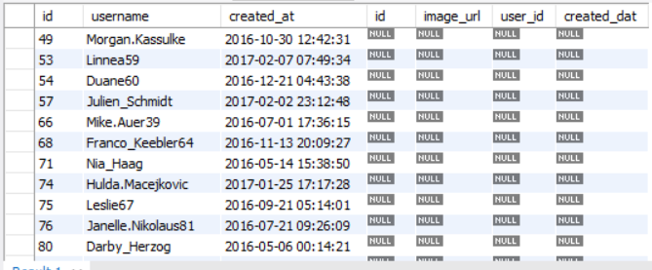
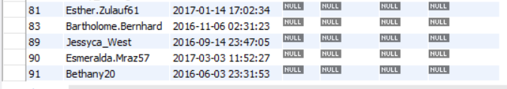
Q.2 Identify users who have never posted a single photo on Instagram.

Slide 5
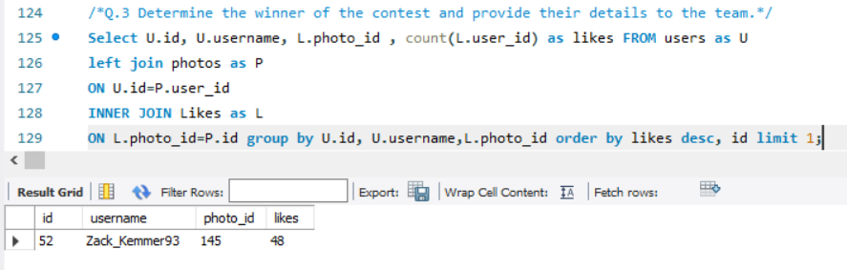
Q.3 Determine the winner of the contest and provide their details to the team.

Slide 6
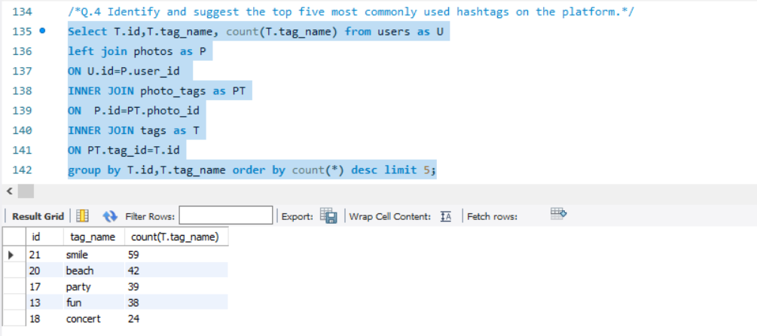
Q.4 Identify and suggest the top five most commonly used hashtags on the platform.*/

Slide 7
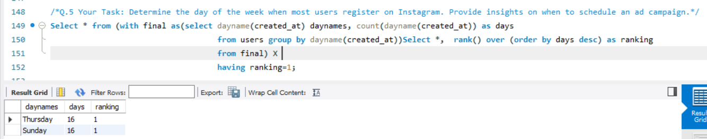
Q.5 Determine the day of the week when most users register on Instagram. Provide insights on when to schedule an ad campaign.

Slide 8
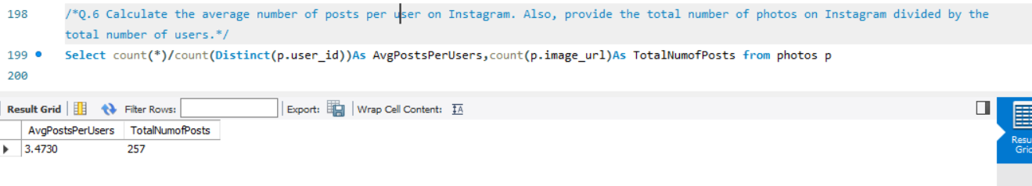
Q.6 Calculate the average number of posts per user on Instagram. Also, provide the total number of photos on Instagram divided by the total number of users.

Slide 9
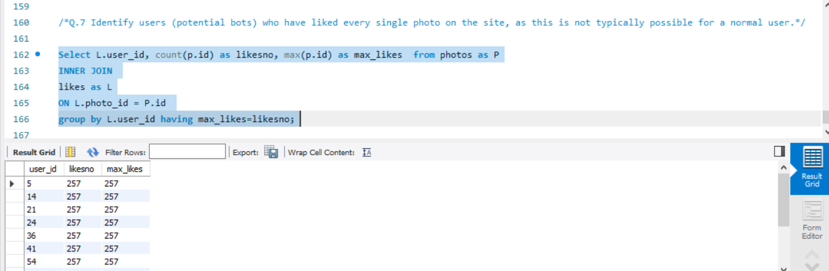
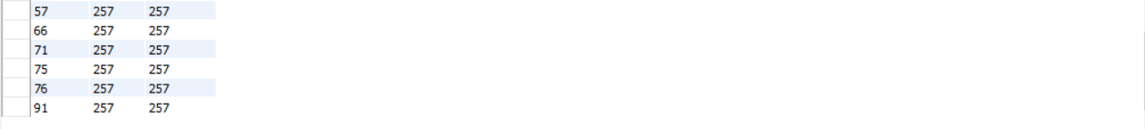
Q.7 Identify users (potential bots) who have liked every single photo on the site, as this is not typically possible for a normal user.

Slide 10
Insights
1. With this project I had understanding of how to use various SQL commands.
2. We have filtered the data of 27 users who have never shared a picture. The Marketing team can encourage them to use Instagram.
3. On Thursday and Sunday most people register on Instagram it’s a good day to start an Ad campaign
4. There are 13 users which are actually artificial Bots since they have been liking every picture. The Instagram team can dive deep into this to find out who are there behind this potential bots.

